Slide 1
GIRL POWER & FEMINISM IN SCHOOLS
(Professor Emma Renold, Cardiff University)

Slide 2
http://www.womankind.org.uk
http://www.feminist.org/global/index.asp

Slide 3
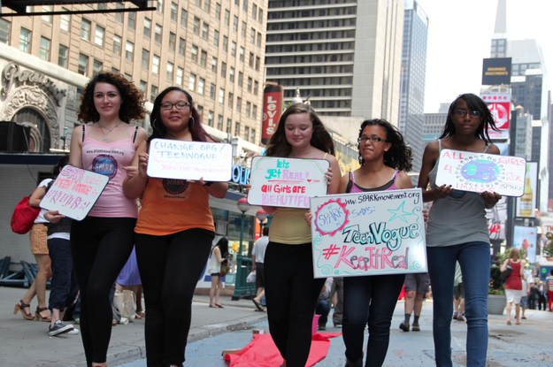
http://www.sparksummit.com/

Slide 4
FIND OUT ALL ABOUT THEM … http://www.girlsinc.org/
BECOME A MEMBER …. https://www.girlsinc-online.org/

Slide 5
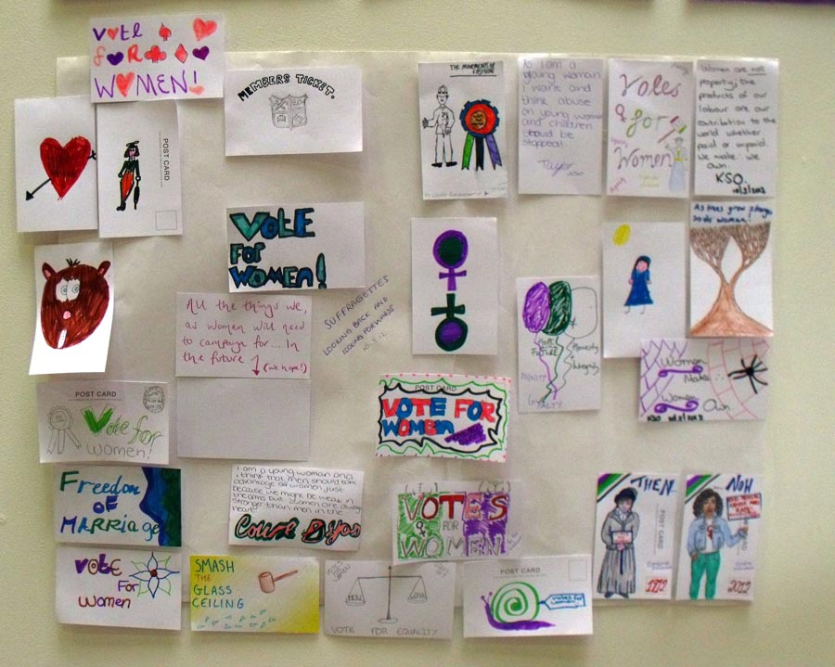
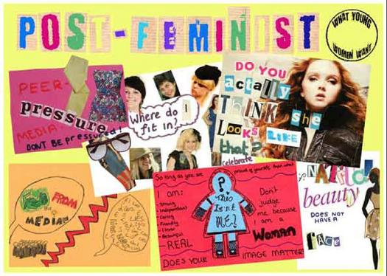
For events, resources and links visit http://www.feministwebs.com/

Slide 6
GIRLS inc. BILL OF RIGHTS
Girls have the right to be themselves and to resist gender stereotypes
Girls have the right to express themselves with originality and enthusiasm
Girls have the right to take risks, to strive freely and to take pride in success
Girls have the right to accept and appreciate their bodies
Girls have the right to be confident in themselves and to be safe in the world
Girls have the right to prepare for interesting work and economic independence

Slide 7
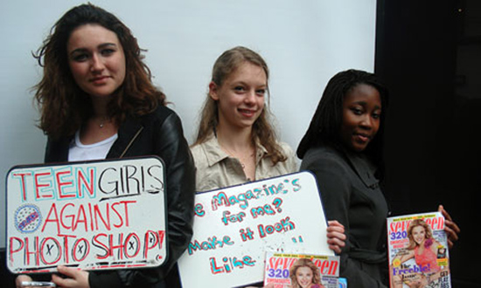
Take a look at this transformation!! http://news.yahoo.com/9-astounding-photoshop-transformations-videos-181157995.html
http://www.change.org/en-CA/petitions/teen-vogue-give-us-images-of-real-girls

Slide 8
http://www.missrepresentation.org/

Slide 9
The F-Word@thefwordukThe twitter account for The F-Word feminist website.UK · http://www.thefword.org.uk/
Guerrilla Girls@guerrillagirls
GUERRILLA GIRLS, The one and only group of feminist activists and artists. Reinventing the f word -- feminism. #guerrillagirlsNew York and everywhere · http://www.guerrillagirls.com/
The FBomb@the_fbombBadass teenage feminists who give a sh*t unite! Founder/Editor Julie Zeilinger (@juliezeilinger) tweets the posts that teens from all over the world write.· http://thefbomb.org

Slide 10
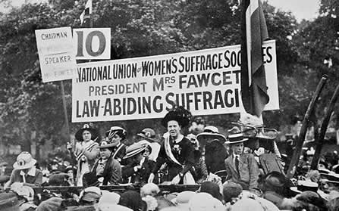
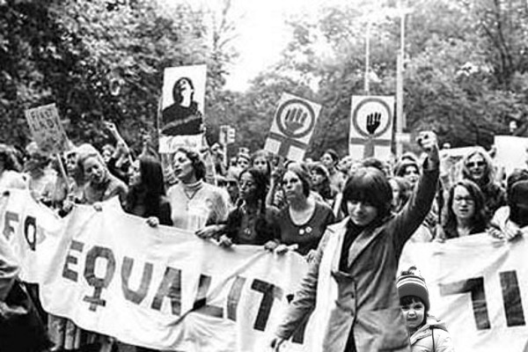
http://www.womenshistorymonth.gov/
http://www.womenshistorynetwork.org/
http://www.bbc.co.uk/wales/history/sites/themes/women.shtml
http://www.bbc.co.uk/archive/70sfeminism/

Slide 11
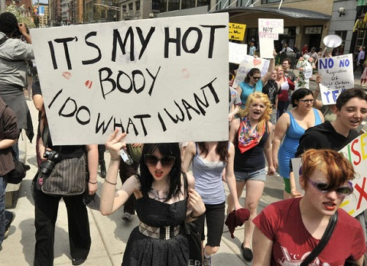
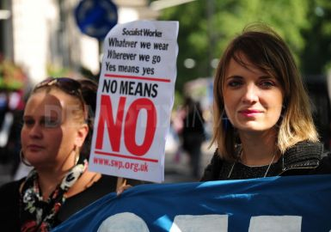
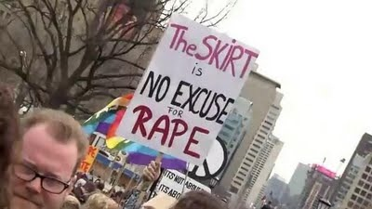

Slide 13
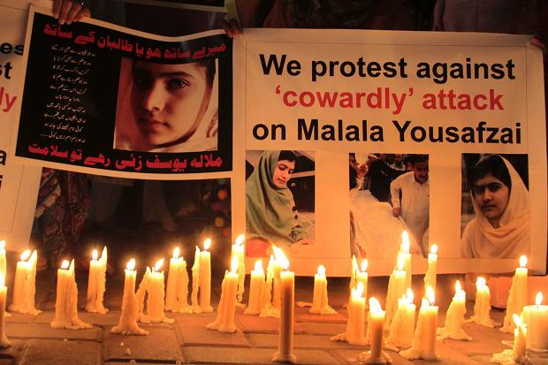
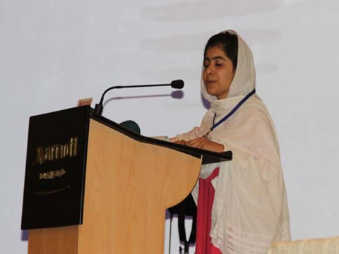

Slide 14
Everyday feminism for everyday sexism
http://www.guardian.co.uk/commentisfree/2011/sep/15/topman-tshirts-misogyny-commonplace-mundane
http://weareequals.org/blog/the-rise-of-everyday-feminism/
http://www.everydaysexism.com/

Slide 15
Getting started …

Slide 16
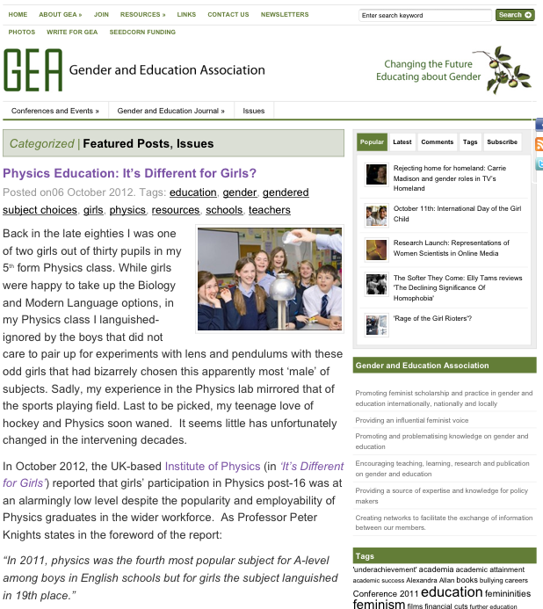
Gender and Education Association http://www.genderandeducation.com/

Slide 17
The Astell Project http://www.astellproject.org.uk/

Slide 18
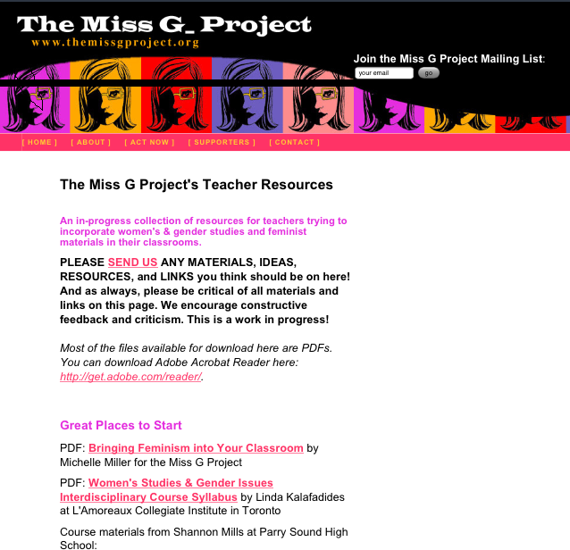
The Miss G Project http://www.themissgproject.org/teachers/

Slide 19
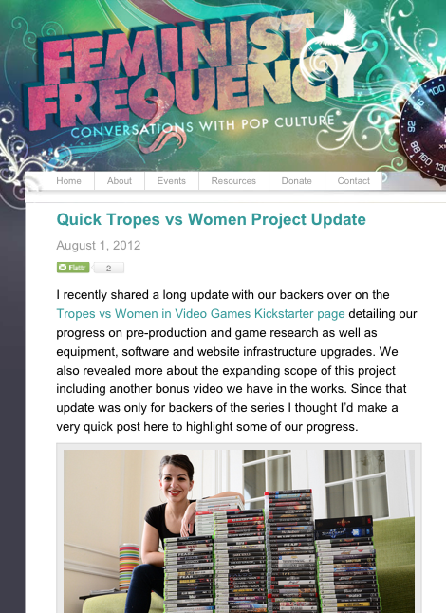
Feminist Frequency http://www.feministfrequency.com/

Slide 20
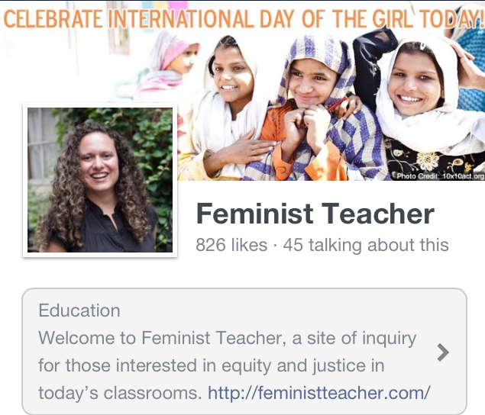
Feminist teacher http://feministteacher.com

Slide 21
What would be your bill of rights? And could the boys join in to create it?
What would your facebook campaign be?
What kinds of small or big protests would you like to get involved in, or create for yourselves?
How might you get started?

